Slide 1




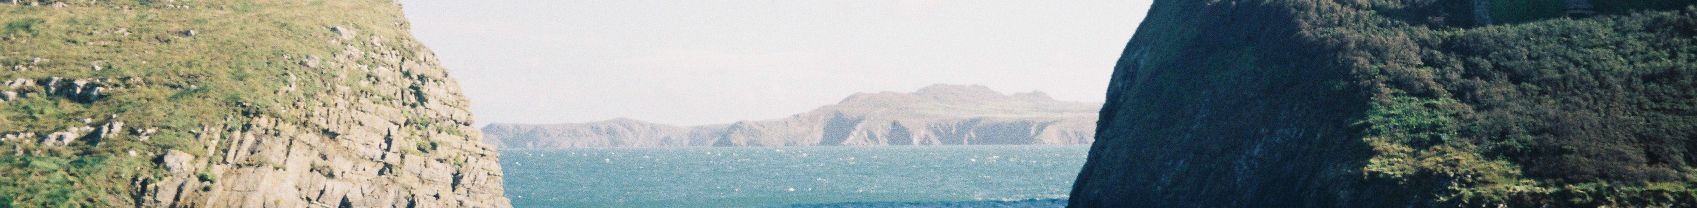
https://twitter.com/WNZ2035
https://netzero2035.wales
https://www.linkedin.com/groups/12830110/
https://toot.wales/@WNZ2035

Slide 2
Our mandate
The Wales Net Zero 2035 Challenge Group was established in January 2023 to deliver on a specific commitment in the formal Co-operation Agreement between the Welsh Government and Plaid Cymru.
The Co-operation Agreement: 2021
A Greener Wales to Tackle Climate Change and the Nature Emergency
‘Commission independent advice to examine potential pathways to net zero by 2035 – the current target date is 2050. This will look at the impact on society and sectors of our economy and how any adverse effects may be mitigated, including how the costs and benefits are shared fairly.
https://www.gov.wales/sites/default/files/publications/2021-11/cooperation-agreement-2021.pdf

Slide 3
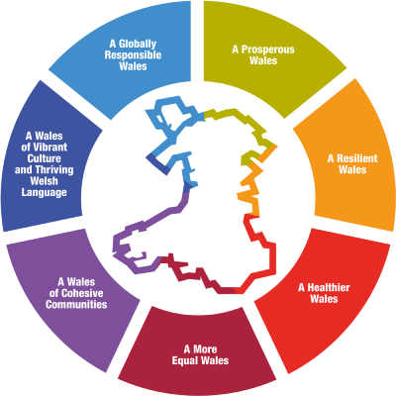
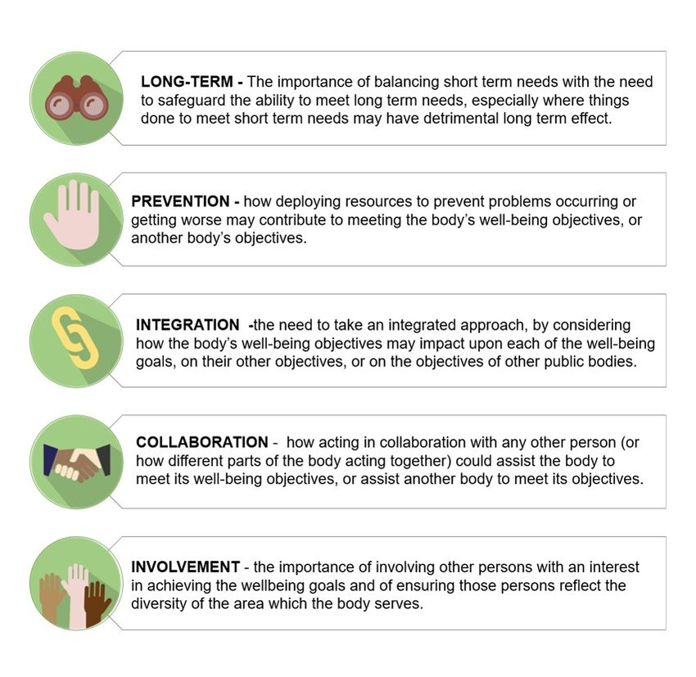
Well-being of Future Generations Act (Wales) 2015
The expert advice will consider pathways to achieve net zero by 2035, that are compatible with the ambitions of both the goals and ways of working of the Well-being for Future Generations (Wales) Act (2015).
https://www.gov.wales/sites/default/files/publications/2021-10/well-being-future-generations-wales-act-2015-the-essentials-2021.pdf

Slide 4
Our five Wales Net Zero 2035 Challenges
How could Wales feed itself by 2035?
How could Wales meet energy needs by 2035 whilst phasing out fossil fuels?
How could Wales heat and build homes and workplaces by 2035?
How could people and places be connected across Wales by 2035?
What could education, jobs and work, look like across Wales by 2035?
The Group is organising its work through a series of Challenges posed as questions, intended to stimulate thinking beyond the typical boundaries of sectors. Doing so will enable the Group to better identify interventions with potentially transformative impacts.
The Group is seeking evidence to underpin accelerated pathways that will achieve net zero outcomes by 2035 and which have co-benefits particularly in the context of a just transition and being nature positive.
Challenges
Net Zero 2035
https://netzero2035.wales/the-challenges/

Slide 5
Our crosscutting 'domains'
Education & Skills
Governance & Legal
Psychology & Behaviour
Engagement & Communication
Just Transition
Finance
Futureproofing
Circular economy
International impacts
Environment
Co-benefits
The Group is also exploring a series of crosscutting themes, which will be considered as part of each challenge.
They are intended to ensure we are thinking holistically and addressing the key enabling factors for a net zero transition, from finance to public engagement
Domains
https://netzero2035.wales/submit-evidence/evidence-submission-annex-for-information/

Slide 6
Our participation model
Through our open calls for evidence per each Challenge
Through the Insitute of Welsh Affairs to host a citizens assembly
Through the Wales Youth Parliament to test our conclusions with young people in Wales
Through partner organisations to test and socialise our conclusions
Through relevant stakeholders and the public through the work of our Challenge groups
We recognise the critical importance of public engagement for the success of our work and a net zero transition.
In keeping with the Well-being of Future Generations (Wales) Act's five ways of working, namely Long Term, Prevention, Integration, Collaboration and Involvement, the Group has a number of mechanisms for participation and engagement
Participation
&
Engagement

Slide 7
Our framework
Planetary boundaries
Well-being of Future Generations (Wales) Act 2015
The Net Zero Wales 2035 Group is providing independent advice to Welsh Government and Plaid Cymru
We have identified five key climate challenges for net zero by 2035;
We have agreed plans for participation and engagement to enable meaningful input
The crosscutting domains are to ensure our
thinking is holistic;
Our processes and outcomes are designed to deliver on the Well-being of Future Generations (Wales) Act goals and ways of working;
The Act requires Wales 'to recognise the limits of the global environment' i.e., planetary boundaries and act accordingly
Crosscutting domains
Participation & Engagement
Crosscutting domains
Challenges
Net Zero 2035

Slide 8
Our timeline
This diagram details our timeline of activities, through to July 2024, when we will present our advice to Welsh Government and
Plaid Cymru.
Any questions please contact:
Stan Townsend
Group Secretary
stan.townsend@wcpp.gov.uk
​
Jan – Jun 2023 – set up: goals, ways of working, challenge setting, challenge reference groups, public participation arrangements, reporting structures
July to December 2023 – collection of evidence: including open public consultation on challenges – food, energy, buildings, connections, education and the future of work
Jan – March 2024 – synthesis of evidence & development of draft conclusions: including further evidence gathering and testing of draft conclusions
April – May 2024 – testing draft conclusions: test draft conclusion through citizens’ assembly, Welsh Youth Parliament, partner events, public, private and community sectors
June – July 2024 – finalise report for presentation: event to present deliverable pathways to Co-operation Agreement partners at Senedd

